Slide 1

SAP Build Training for Corporate Professionals
DAY-24
www.anubhavtrainings.com

Slide 2


DISCLAIMER
The training content and delivery of this presentation is confidential, and cannot be recorded, or copied and distributed to any third party, without the written consent of Anubhav Trainings

Slide 3
Agenda
Create Cart Order
Add items to cart
Update total value
Deploy Build Process for approval

Slide 4

Scenario – Shopping cart App
🧑‍💼 Persona: Alex Taylor – Procurement Manager
Age: 34
Location: Chicago, USA
Industry: Manufacturing
Role: Manages procurement for factory suppliers
Goals:
Quickly find suppliers
Ensure availability to take orders based on size
anage suppliers
🎯 Objective
Design a user-friendly mobile app that allows Alex to:
Browse available products
View detailed product information
Add items to a shopping cart
Place and track orders

Slide 5
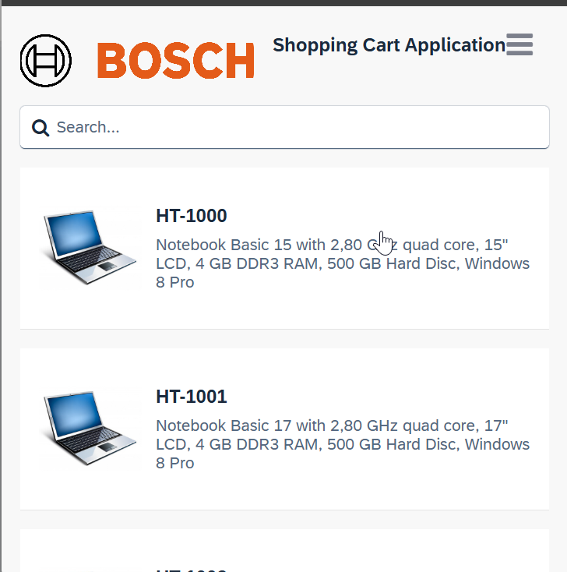
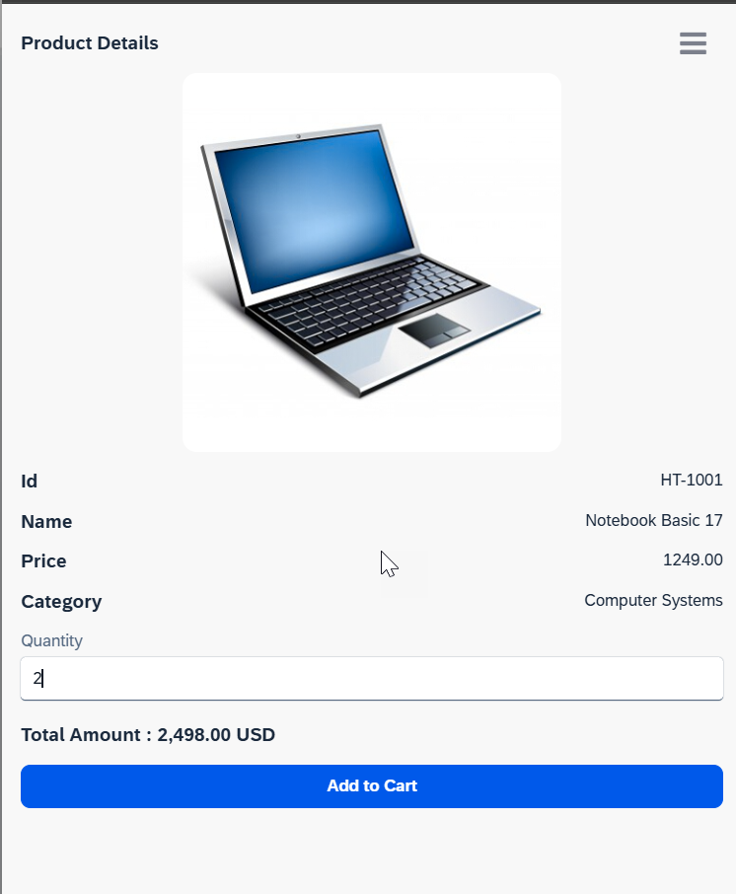
















Slide 6
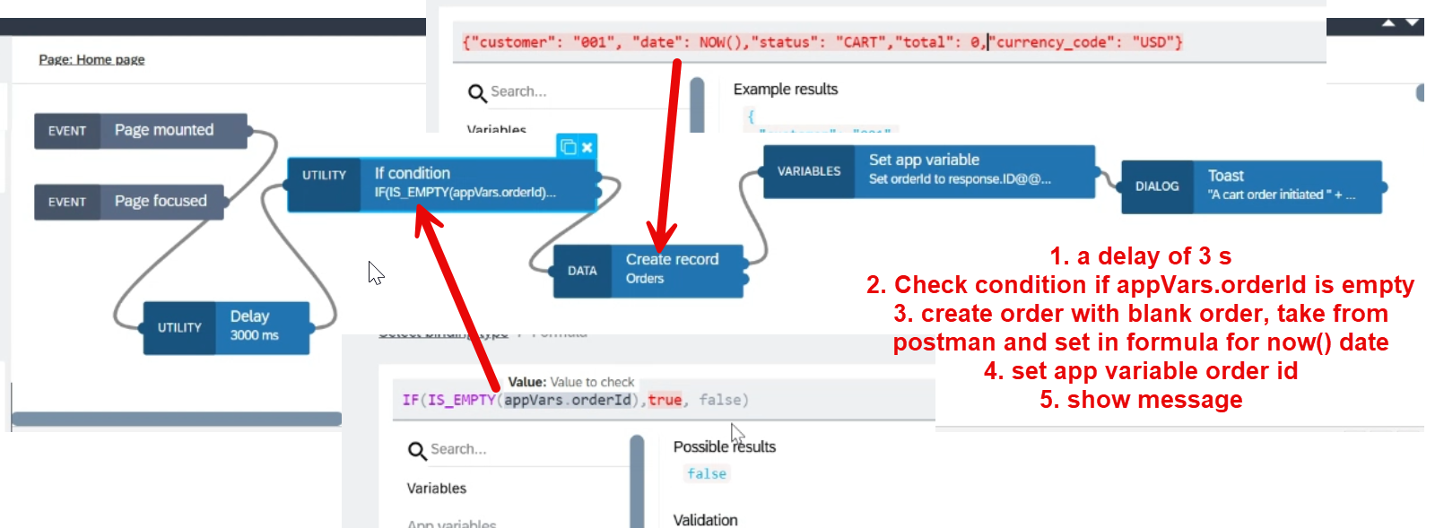
Empty Cart create

Slide 7
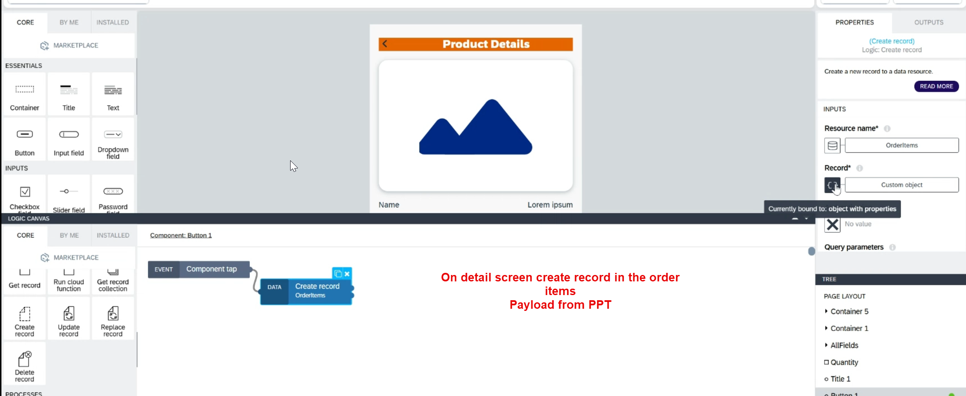
Add to Cart

Slide 8
Create Cart Payload
{ "product": data.singleProductSelected.Name, "quantity": pageVars.quantity, "price": data.singleProductSelected.Price, "total": NUMBER( pageVars.quantity * data.singleProductSelected.Price), "currency_code": "USD", "order_ID": appVars.orderId }

Slide 9
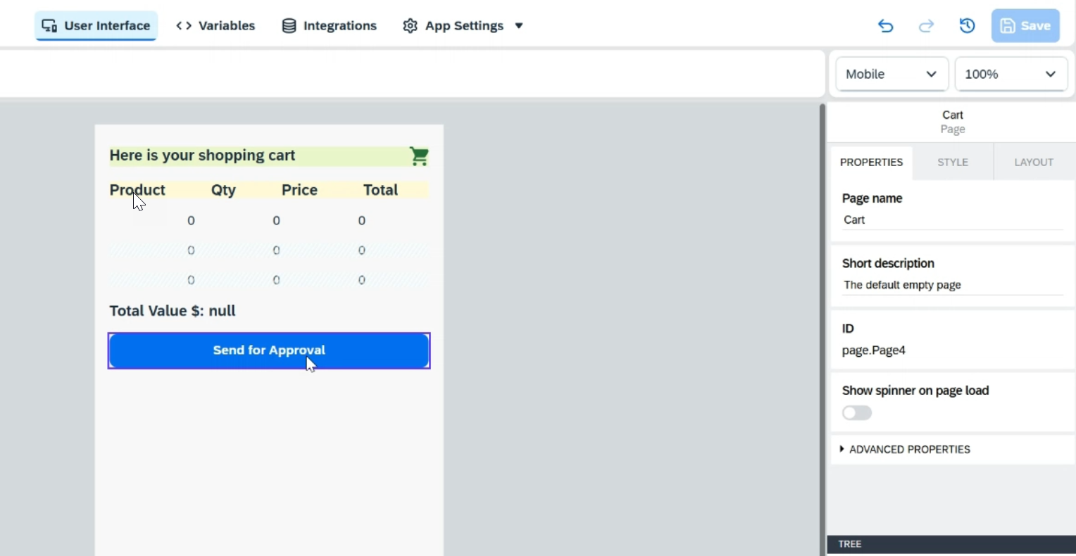
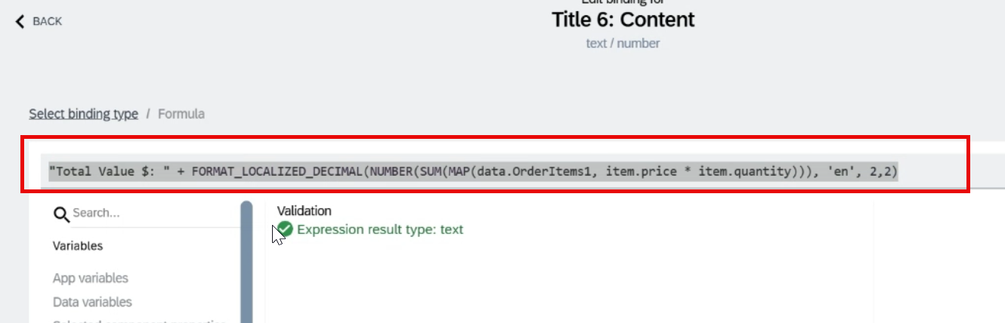
Add a new Cart Screen to view cart

Slide 10


Scenario
Build Process Automation
BTP
Sales Order
(Build Apps)
approval
<data>
app
rej
Manager
<data>
Sales Representative
Build workzone
My Inbox
S/4HANA

Slide 11
Scenario
https://help.sap.com/docs/build-process-automation/sap-build-process-automation/configure-sap-build-process-automation-destinations

Slide 13

What We Did
Let’s Summarize
www.anubhavtrainings.com

Slide 14
www.anubhavtrainings.com
Thank You
End of Day 24
www.anubhavtrainings.com

Slide 15



We’re committed to empower you to be
#FutureReady
through powerful training solutions.
We build the workforce of the future.
250+
Corporate Clients
30,000+
Learners Trained
25000+
Learners Placed
FREE WEBINARS
Sign up for free webinars with industry experts every fortnight!
Enroll Now!
Contact us today!
https://anubhavtrainings.com

